Slide 1

Course : Exploratory Data Analysis
Class & Div : IV E
Course Project Title : Covid 19 Vaccination Analysis
Team members
Anand Sagar-564
Ateeth KJ -546
Shakti Kumar Singh- 548
Shivam Singh-557

Slide 2
Problem Statement
To solve the problem of efficient Vaccine Distribution by analyzing several factors affecting the distribution of vaccine and number of covid-19 cases in a given region so that none of the regions/Countries run out of vaccine or over-stock the vaccine.
Our ultimate goal is to predict the number of people vaccinated on a given date in a given region so that the region is supplied only ample amount of vaccine not too less than the required neither too much more than required.
The problem mainly affects the poor countries where vaccine distribution is very weak and generally runs out of vaccine and if the problem is not solved then we may see several deaths in future pandemics in these countries.
TEAM 04 KLETECH/SOCSE/EDA/COVID VACCINE ANALYSIS

Slide 3
UNDERSTANDING THE DATASETS
TEAM 04 KLETECH/SOCSE/EDA/COVID VACCINE ANALYSIS

Slide 4
owid-covid-dataset(owid-Our World In Data)
This dataset tracks the total number of COVID-19 vaccinations administered in each country, broken down by first and second doses, and derived daily vaccination rates and population-adjusted figures.
The combination of these metrics enables users to understand the scale and rate of vaccine rollouts relative to population, compare rollout rates between countries and assess differences in priorities for countries with one-dose and two-dose schedules.
These data are compiled from official sources, including health ministries, government reports and official social media accounts.
Source- covid-19-data/public/data/vaccinations at master · owid/covid-19-data · GitHub

Slide 5
Description | Attributes
Information related to Confirmed Cases | total_cases new_cases new_cases_smoothed total_cases_per_million new_cases_per_million
Information related to Confirmed Deaths | total_deaths new_deaths total_deaths_per_million new_deaths_per_million
Information related to Tests & positivity | total_tests new_tests total_tests_per_thousand positive_rate

Slide 6
Description | Attributes
Information related to Vaccinations | total_vaccinations people_vaccinated people_fully_vaccinated total_boosters new_vaccinations total_vaccinations_per_hundred new_vaccinations_per_hundred people_fully_vaccinated_per_hundred total_boosters_per_hundred
Information related to details and development of the country | iso_code Continent Location Date Population gdp_per_capita human_development_index life_expectancy

Slide 7
Description | Attributes
Information related to type of covid vaccines | Pfizer/BionTech Moderna Oxford/AstraZeneca Sinovac Covaxin Cansino

Slide 8
DATA
PREPROCESSING

Slide 9
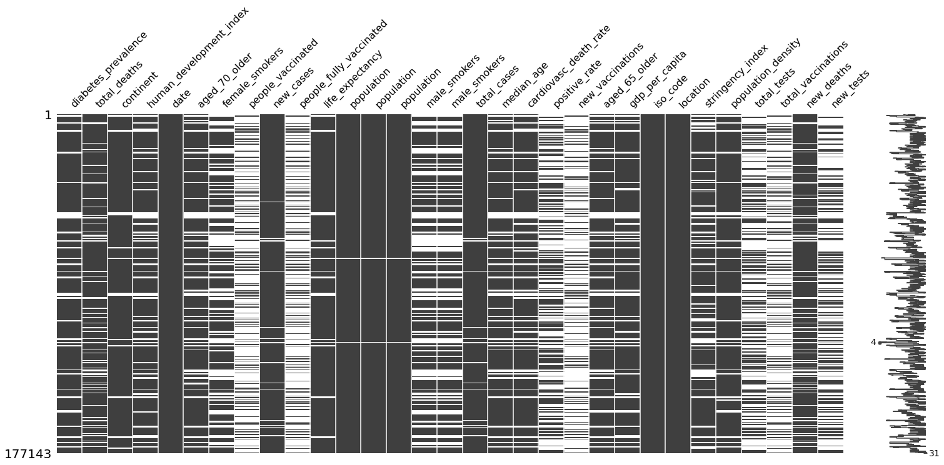
The above heat map tells us if the occurrence of missing values are sparsely located or whether they are located as big chunk
For example in female_smokers we see that there are bigger chunks of missing values where as in total_cases we see that data is missing in very less amount that too very far from each other.
In total_vaccinations we see that data is missing in larger chunks very frequently, We can also see if two columns have almost same number of missing values or not if they are at same index then we can also verify it using Heatmap-null-coorelation Matrix

Slide 10
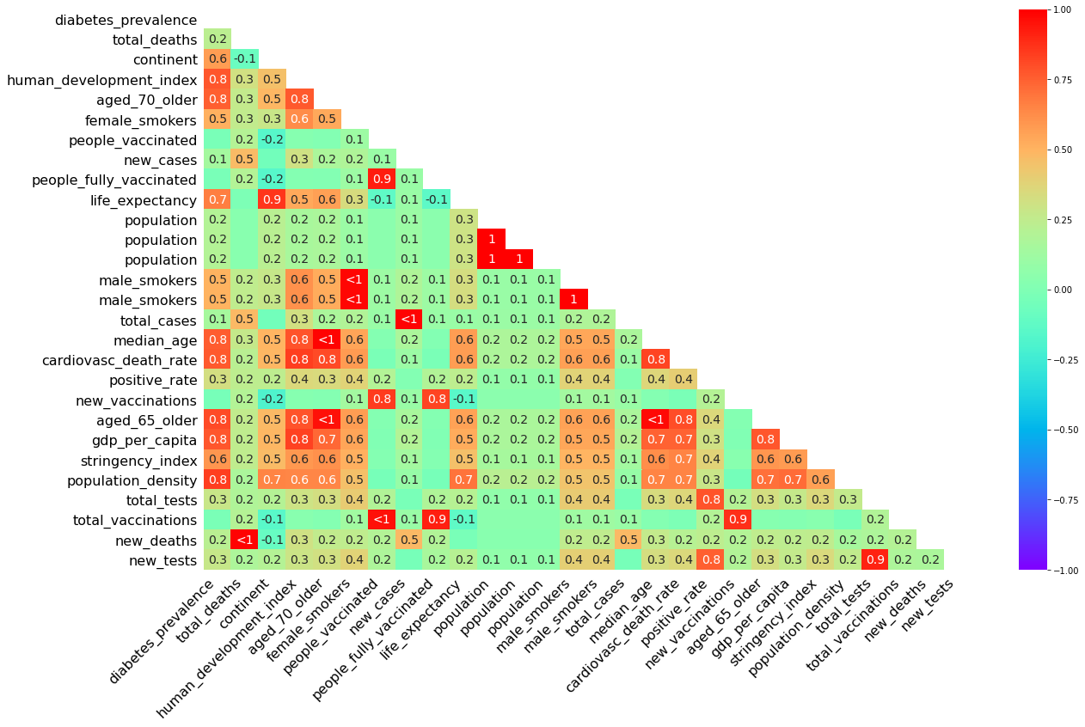
Correlation map of the attributes
From the graph we can see the correlation between different attributes
We have discarded the attributes which were having very less correlation with all other attributes

Slide 11
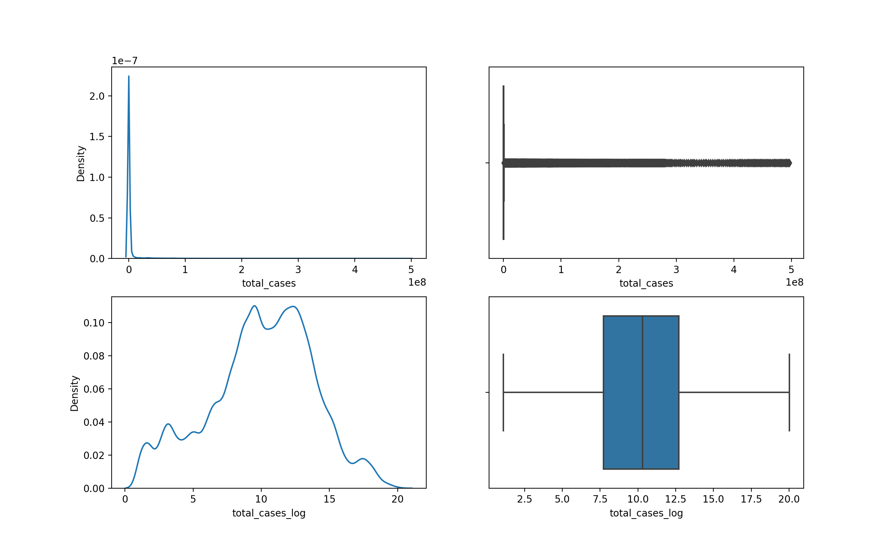
Density and boxplot of before vs after removing skewness
As we can see in the above figure before,the data was highly skewed (13.50), due to which a very high % of data was segregated towards a particular value
Due to that many values were treated as outliers , So we took log of the column after adding 1 to each value of the column to remove skewness.
Now we can see that the data has better distribution now (skewness=-0.3)

Slide 12
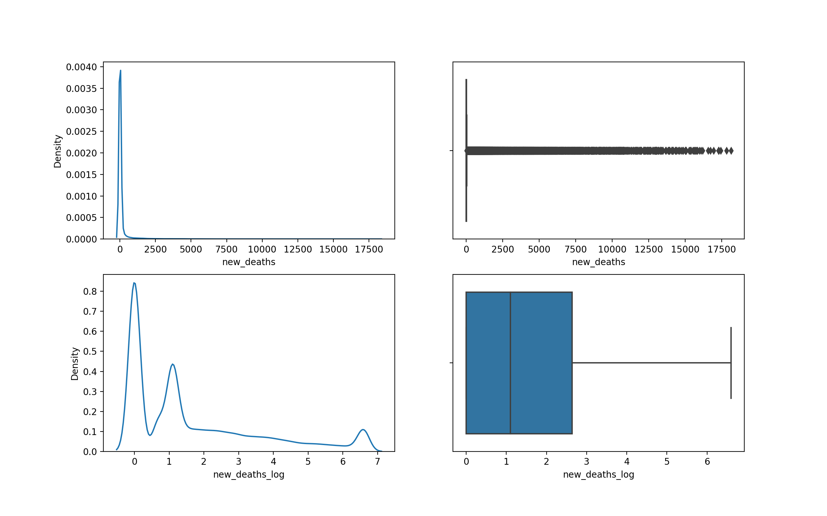
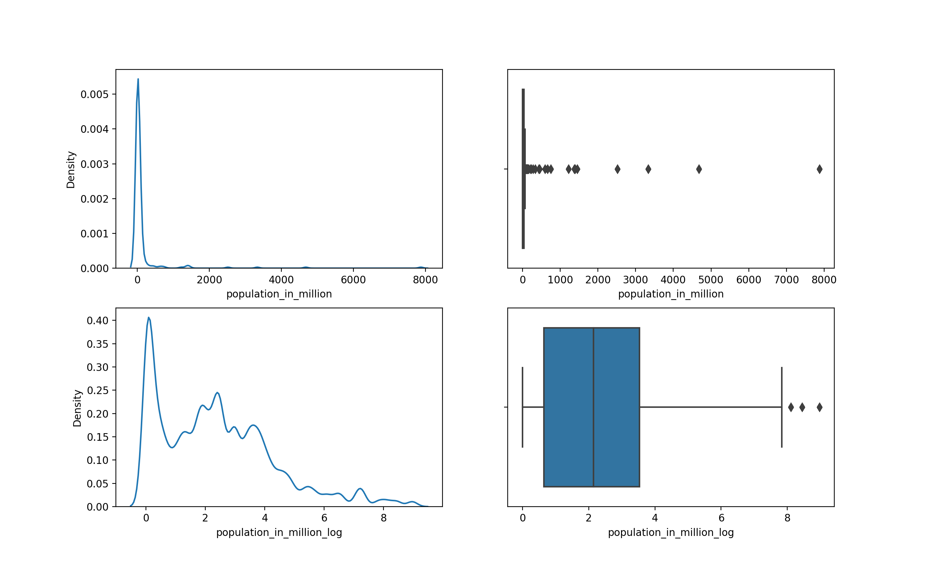
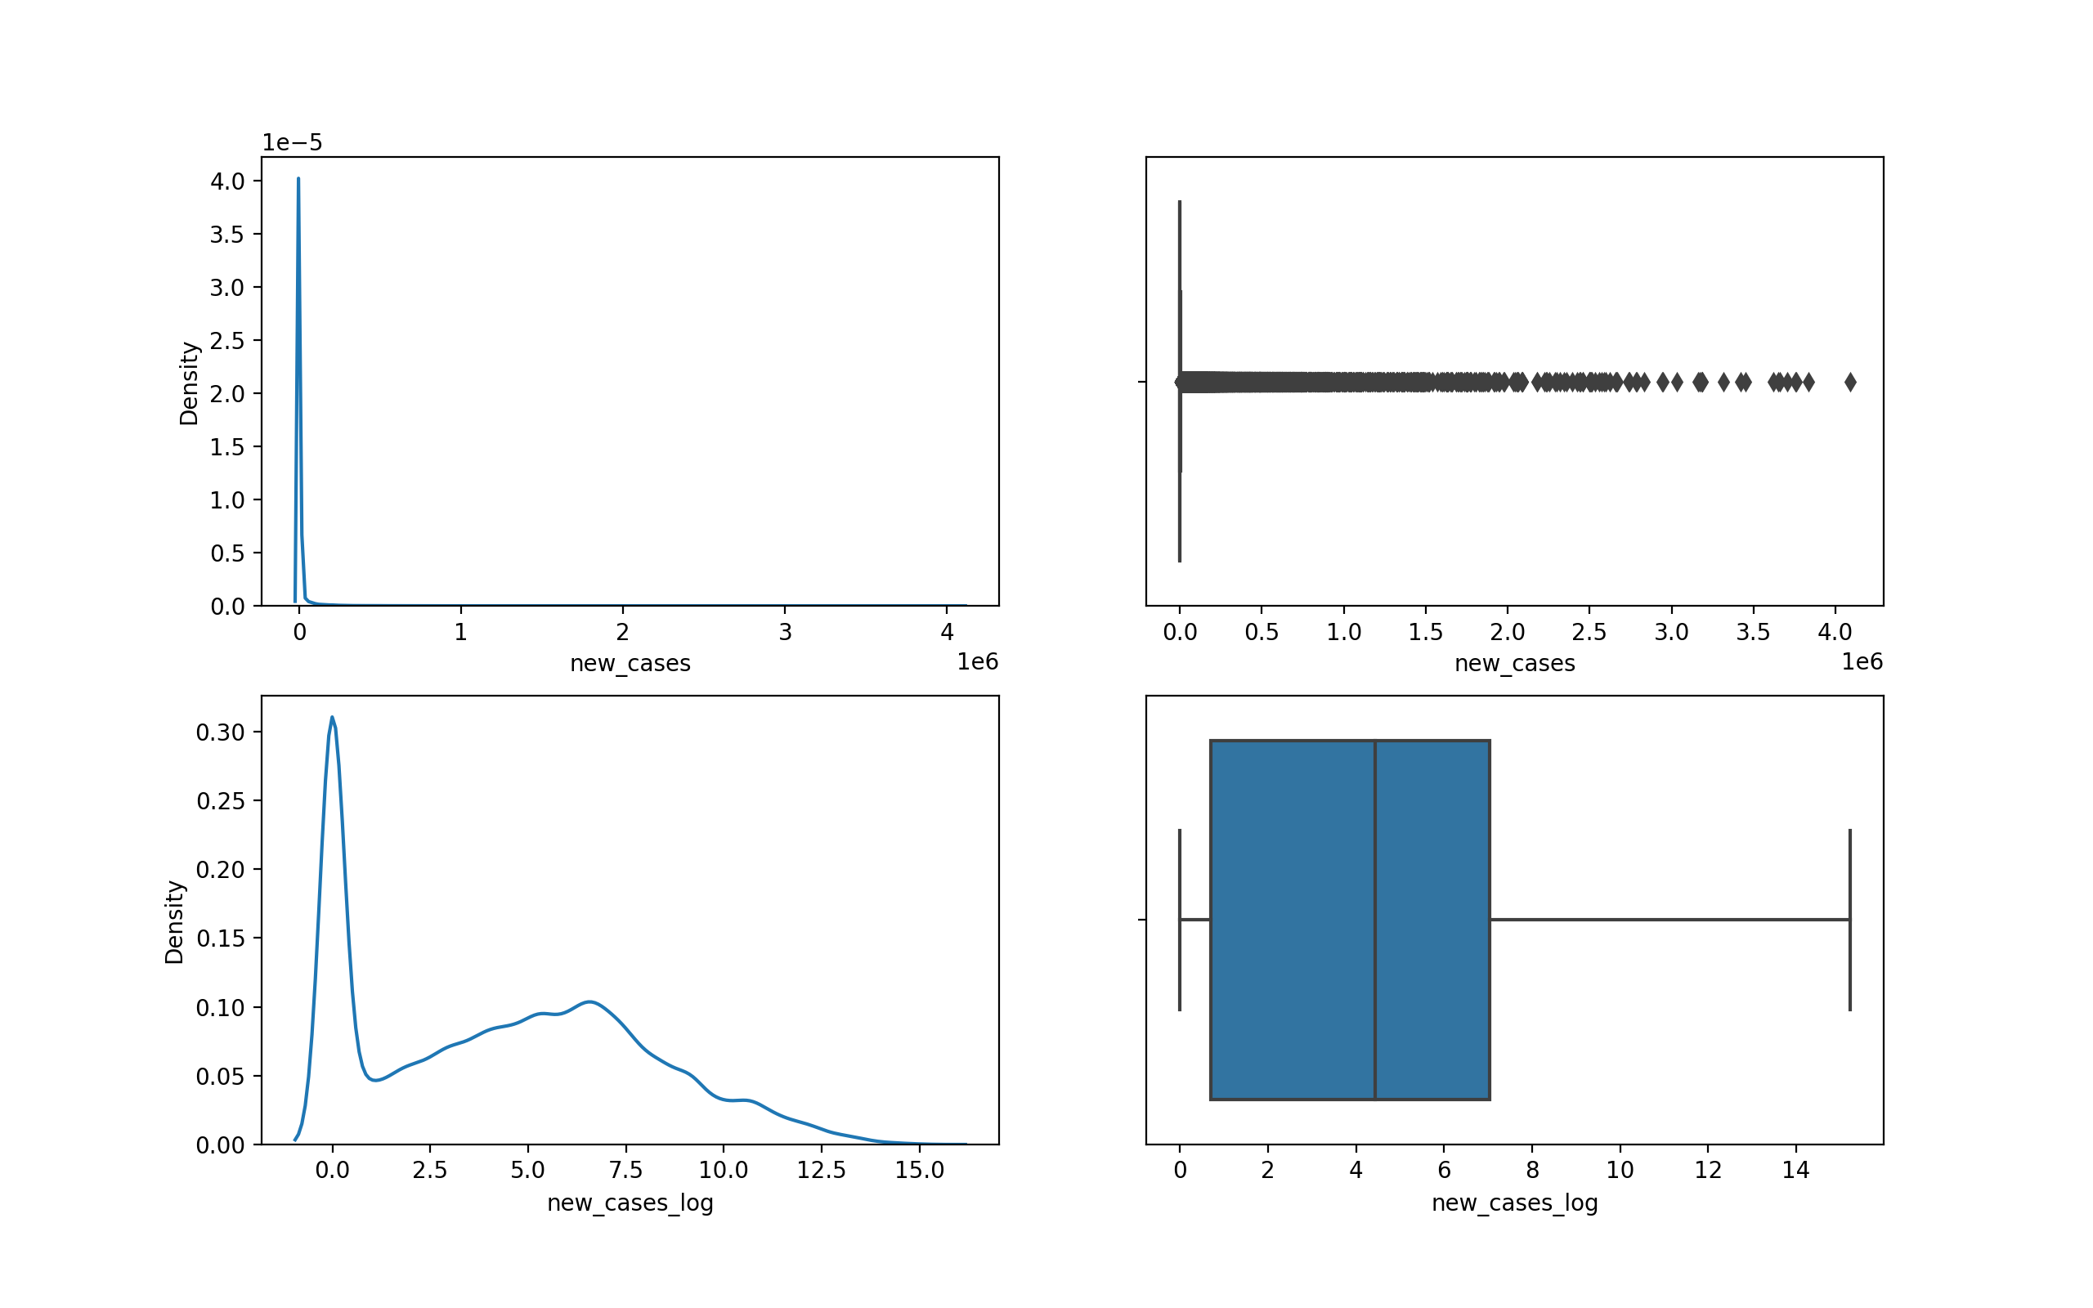
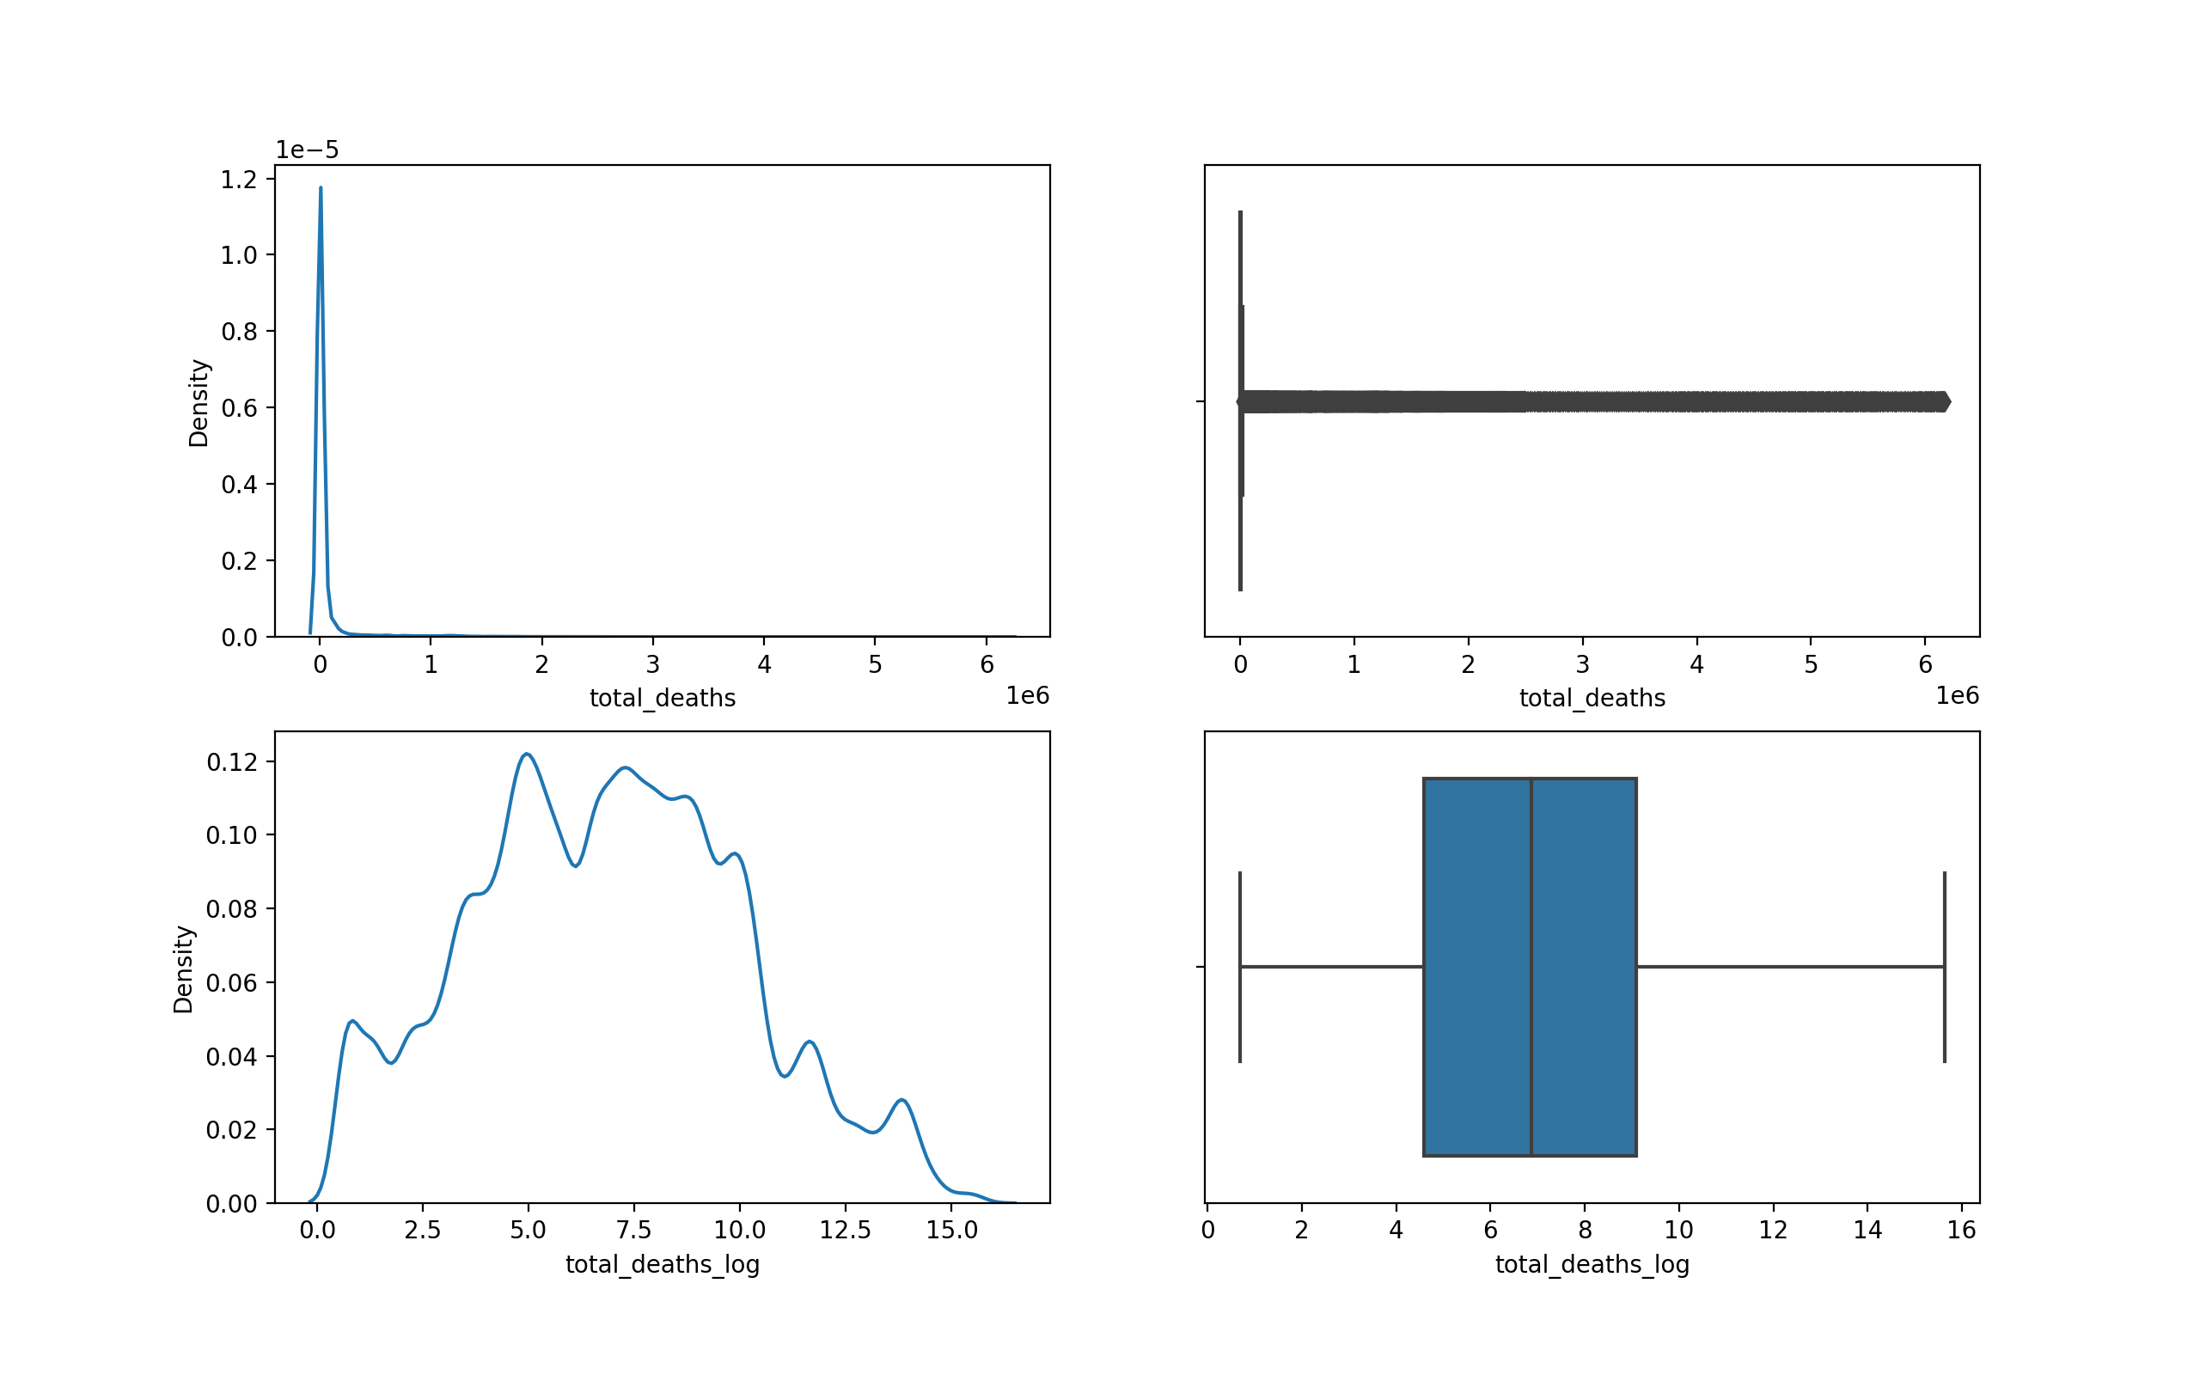
Density and boxplot of before vs after removing skewness

Slide 13
Data Analysis

Slide 14
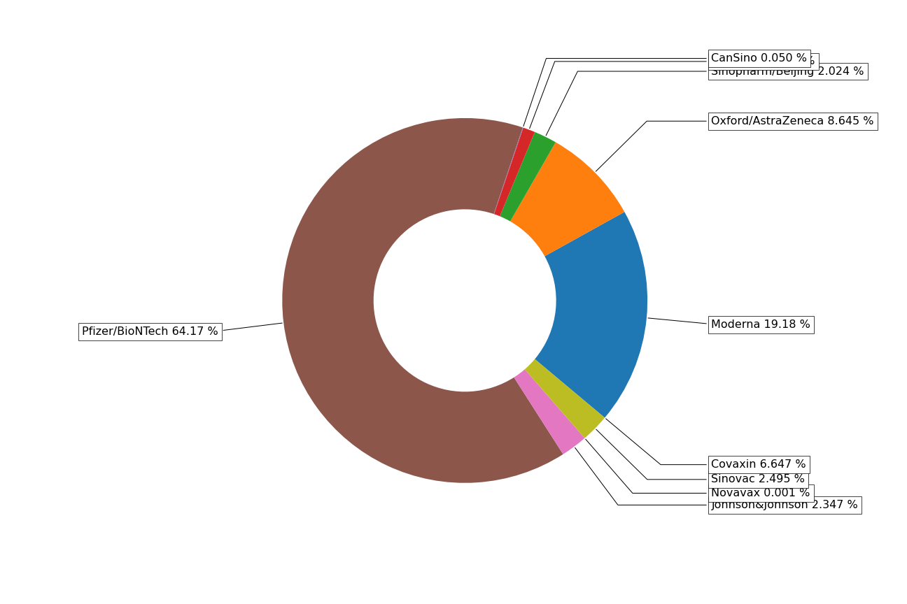
Vaccine Distribution
We can clearly see from the above graph that Pfizer/BioNtech is the most distributed vaccine in the world covering 64% of total vaccinations in the world
Some of the reasons could be
Pfizer was the first to market a coronavirus vaccine -- and the first to gain authorization
It has higher efficacy i.e 95%
As it is a MRNA vaccine it doesn’t have much side effects

Slide 15
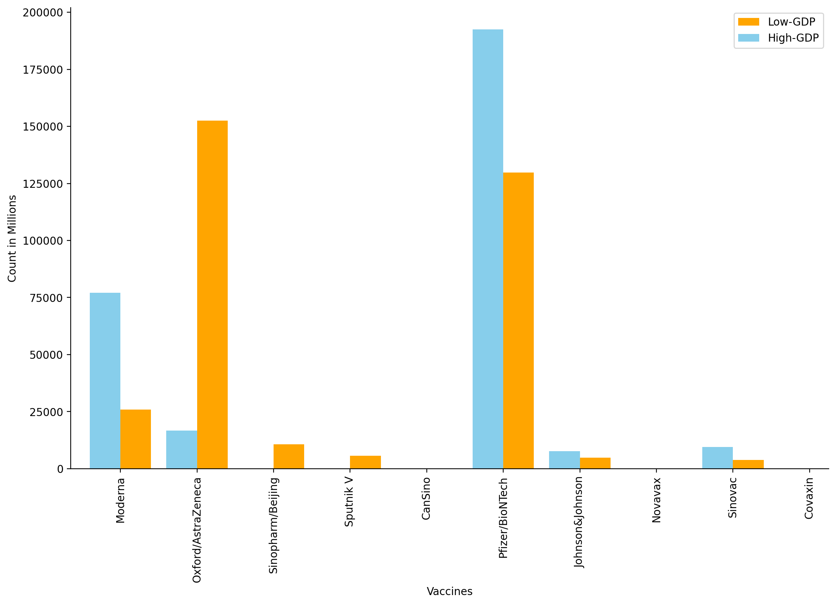
Different Vaccines and its count based on high and low GDP countries
We can observe from the above graph that Oxford and Astrazeneca(covishield) vaccines are used the most in countries with low GDP
The possible reasons could be
It's efficacy is 76%
It is 18 times cheaper than Pfizer.
It can be kept in a freezer just between 2 to 8 degree celsius and can be used upto six months. This is a huge relief for countries with huge population and low GDP.

Slide 16
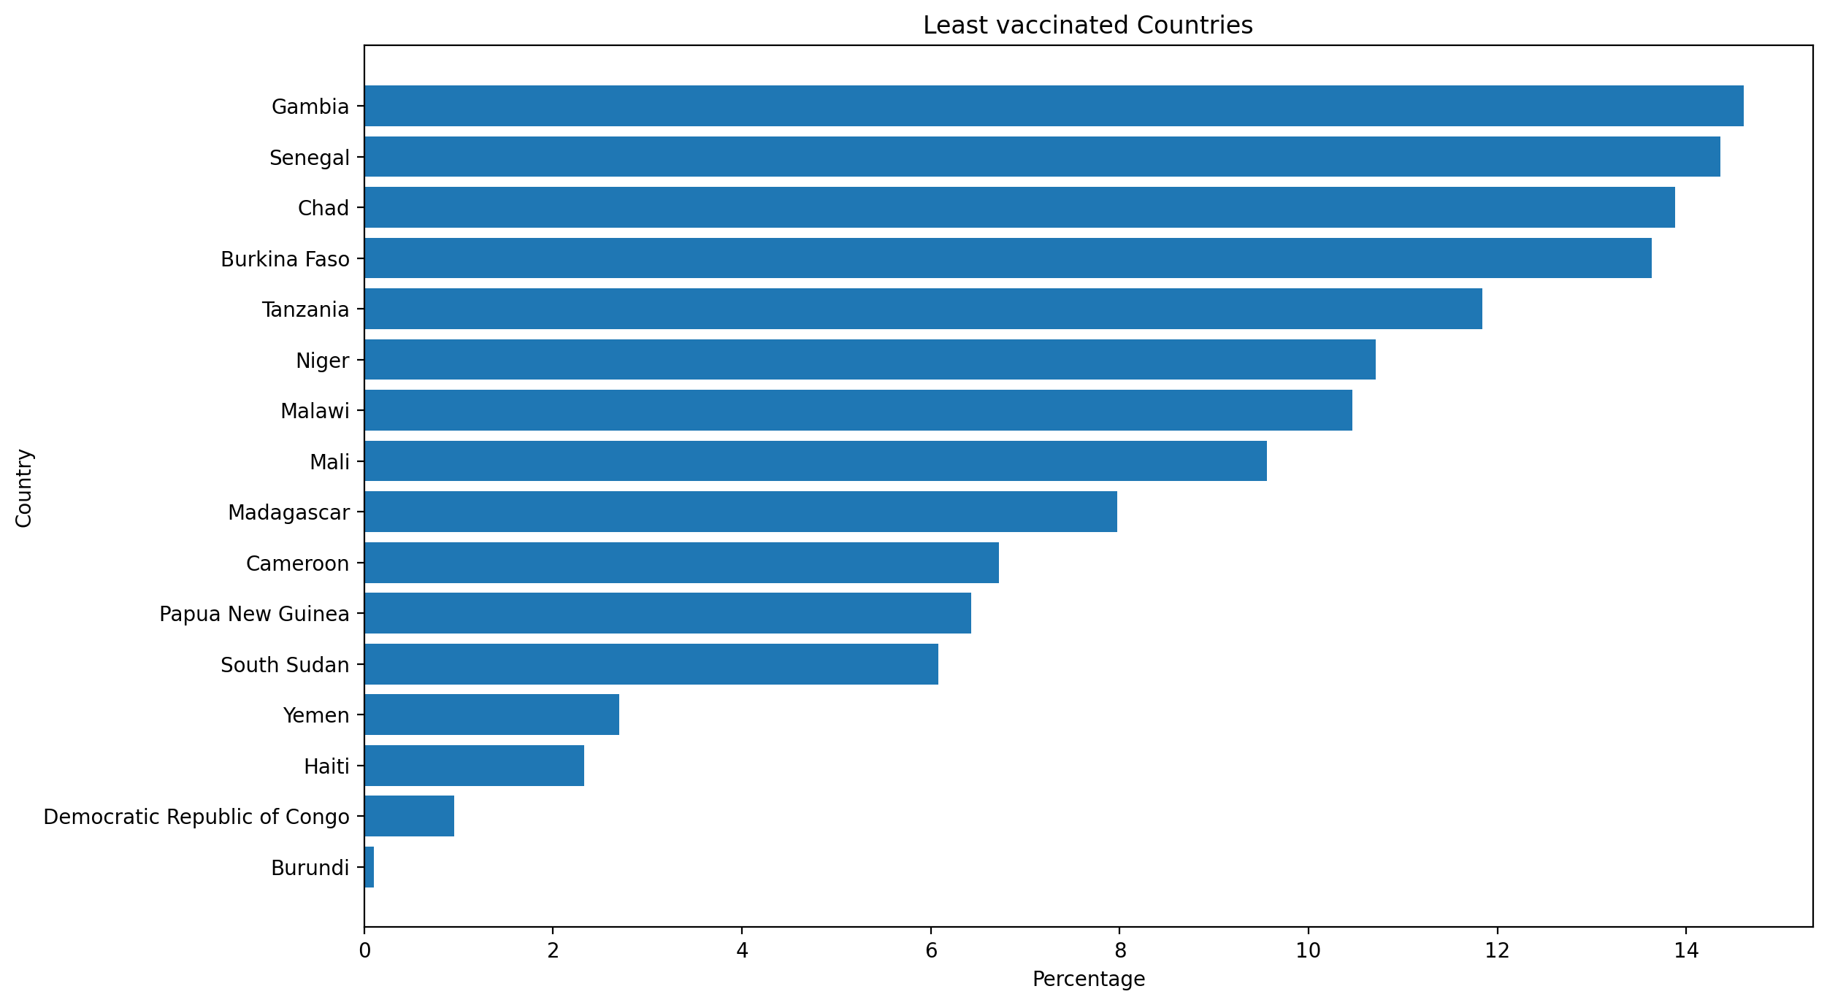
From the above graph we can observe that out of 15 least vaccinated countries 13 are from Africa
In low-income countries, just 5.5% of people have been fully vaccinated against the coronavirus.
Most of the countries are having low GDP and there are countries like Sudan and Yemen where civil war is going on where people have to travel 20-25 hours to get vaccinated
Most of the countries have less literacy rate
where people are unaware of importance of
covid vaccine.
Some of the countries are affected by terrorist organizations where vaccines are being looted before supply
15 Least vaccinated countries of the world

Slide 17
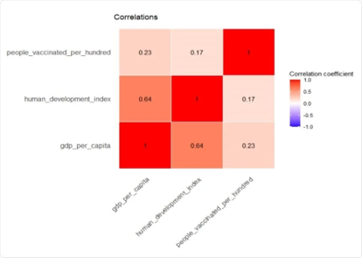
How GDP and Human development Index of the country affect the vaccination drive of the country ?
Which one of the above mentioned factors affect the most and why?
Above correlation table indicates a positive relationship between GDP per Capita, HDI, and the percentage of people vaccinated.
Both of these correlations are not high; however, GDP has a higher correlation than HDI (0.23 Vs. 0.17). Lastly, this table shows a high positive relationship between GDP per Capita and HDI among the countries (0.66).

Slide 18
Higher GDP can support the production, testing, and distribution of vaccines where as countries with lower GDP may suffer in the distribution and production of vaccines.
According to the United Nations Development Program 2020, 43.6 % of participants were from low Human Development Index (HDI) regions, 48.3 % high and very high, and 8.1 % from medium. The overall vaccination hesitancy rate was 37 %.
This implies that Human development index is not a good measure to analyse
vaccination rate of the country.
Hence we infer that higher GDP per capita is significantly associated with greater numbers of vaccinations; however, there was no significant relationship between HDI and vaccine distribution.

Slide 19
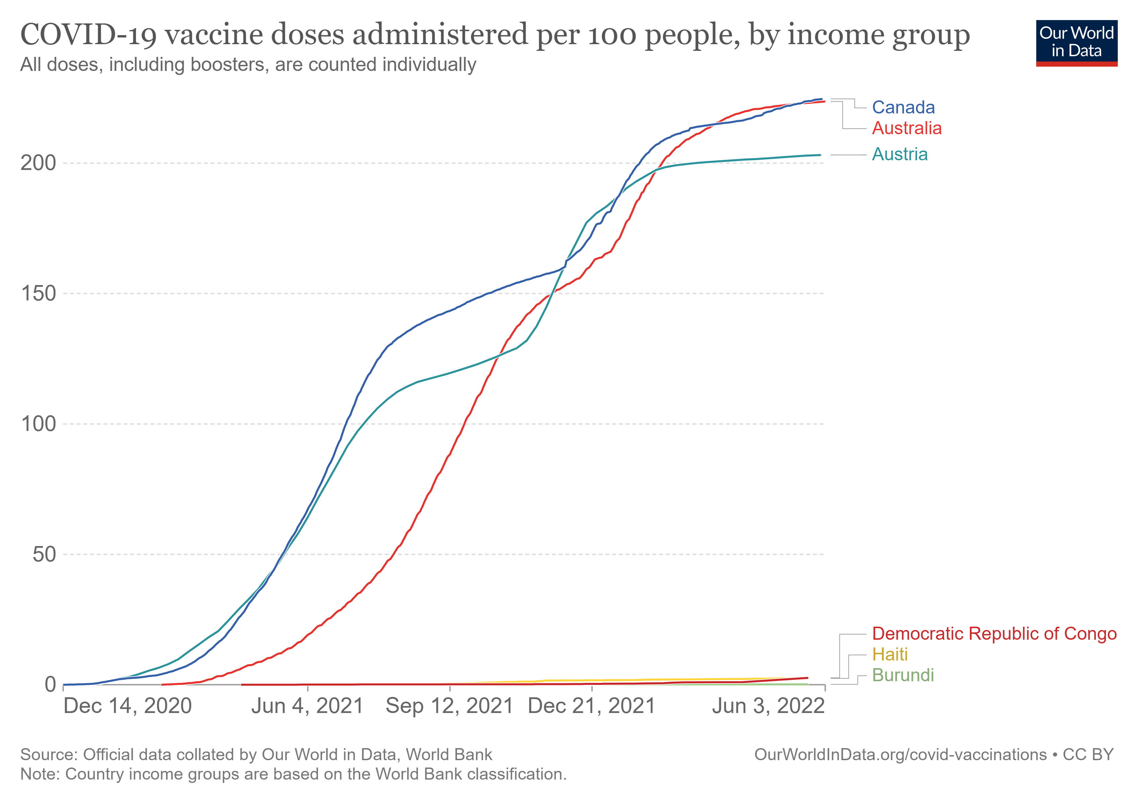
What is the effect on vaccination drives of underdeveloped and developing countries as developed nations are demanding for booster(3rd)doses
Wealthy countries, such as Australia, Austria,Canada etc have secured vaccine supplies and approved the booster shots (3rd doses) for their citizens by negotiating bilateral deals with vaccine manufacturers. Over 3.5 billion vaccines have been distributed globally, but more than 75 per cent of those have gone to just ten countries. Richer countries administered 62 times more shots than poorer countries, according to the WHO.
Many under-developed and developing countries remain burdened by financial constraints, in low-income countries, only 11.4% of the population have been vaccinated with at least one dose. The booster shots in developed countries lead to further delay of vaccination in developing countries. This may cause serious problems, even for developed countries, because it facilitates further mutations of COVID-19 virus, which may lower the efficacy of currently available vaccines.
Vaccination per 100
Date

Slide 20
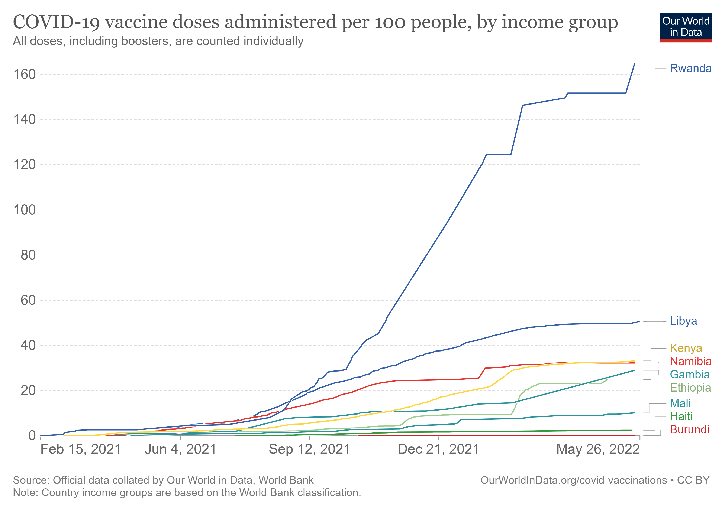
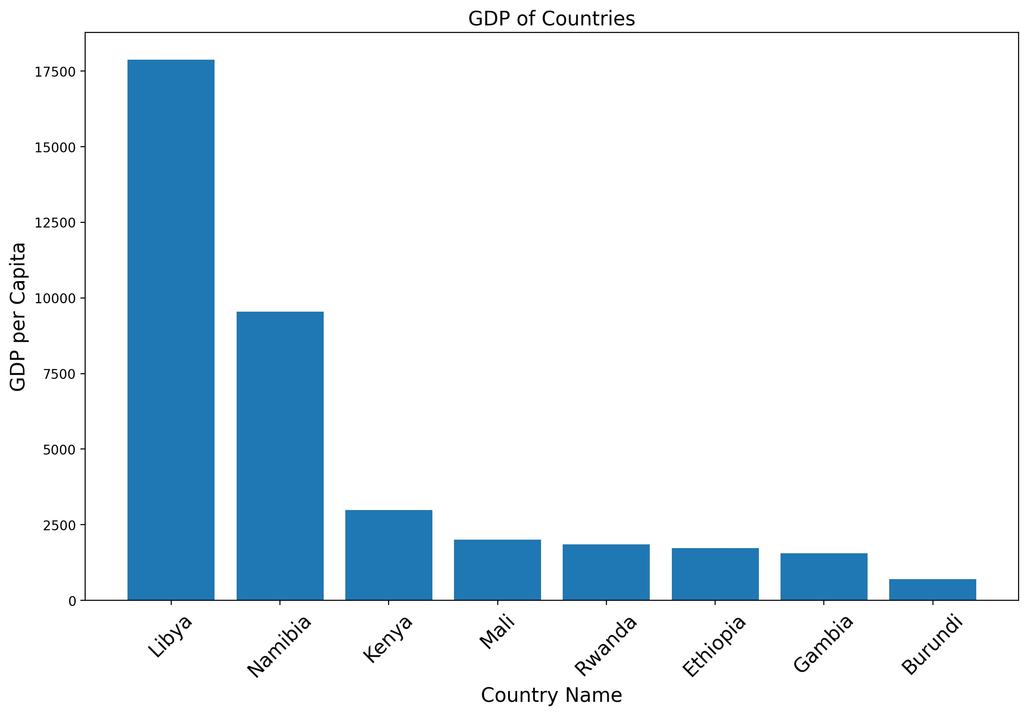
Which country with low gdp has perfomed the best in vaccine distribution compared to other low gdp countries what may be the reason for that and What all stratagies were followed by that country ?
Vaccination per 100
Date

Slide 21
By plotting the graph of vaccination rates of countries with low GDP we observed that vaccination rate of Rwanda was fairly high as compared to other low GDP countries .
By analyzing we got to know that weeks before the vaccines arrived in the Rwanda, the Ministry of Health prepared its storage and distribution capacity. In addition to preparing regular refrigerators used for other vaccines, Rwanda purchased five ultra-low refrigerators to store the Pfizer vaccine at -70 degrees Celsius.
This early logistical planning meant that Rwanda had the capacity to store 5 million doses before the vaccines arrived. The country also purchased refrigerated vehicles to ensure that all corners of the country could be reached.

Slide 22
Model Building

Slide 23
We have used multivariate linear regression model and we are trying predict not just based on single attribute rather we are using 25 important attributes for the prediction
We are able to predict the new daily vaccination of the given country with more than 90% accuracy in some countries
If we can successfully predict the number of vaccines required so that Government authorities can stock the vaccine doses and there will not be any shortage of vaccine and also developed nations will not over stock the vaccines

Slide 24
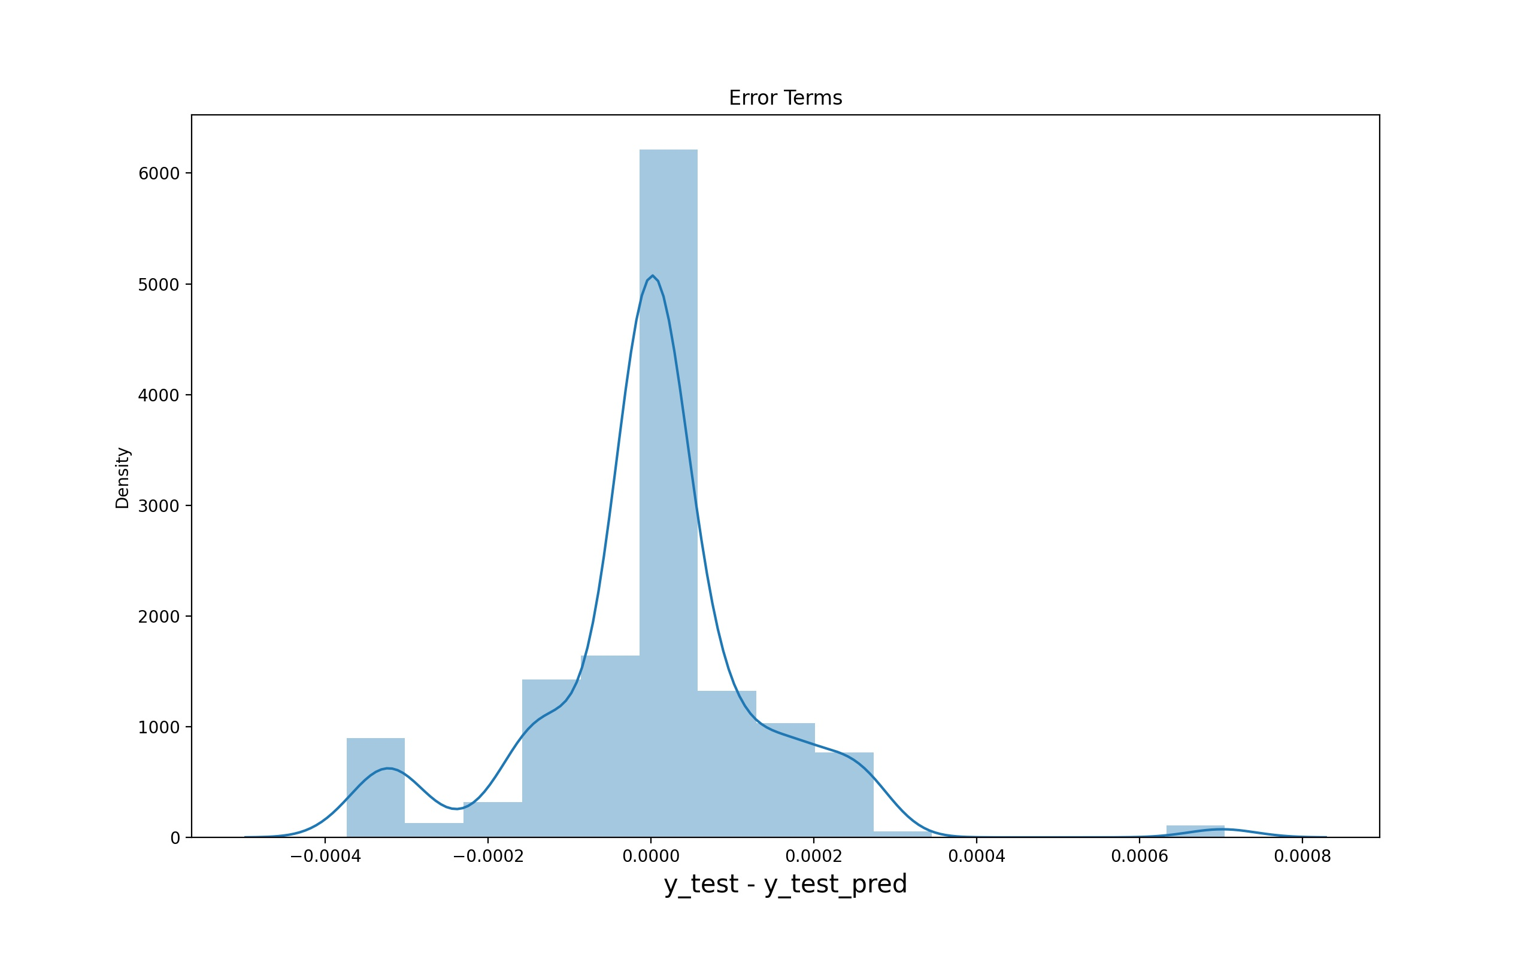
Since we can not visualise multi-dimensional data we have plotted a density plot for error visualization
On X-axis we have Y_test-Y_predicted i.e error
On Y-axis we have density
We can see that large number of points are close to 0 that means large number of values have been predicted correctly

Slide 25
CONCLUSION
As vaccine distribution has been the real challenge for the entire world ,We have seen how factors like GDP effect the vaccination rates of the country We have mainly focused on countries with least vaccination rates and reasons for their low vaccine rates and how can they improve their vaccination rates by following the stratagies adopted by a country whose gdp is low but has high vaccination rate ,Finally we have fitted a multivariate linear regression for predicting new daily vaccination for a given country

Slide 26
By plotting the graph of vaccination rates of countries with low GDP we observed that vaccination rate of Rwanda was fairly high as compared to other low GDP countries .
By analyzing we got to know that weeks before the vaccines arrived in the Rwanda, the Ministry of Health prepared its storage and distribution capacity. In addition to preparing regular refrigerators used for other vaccines, Rwanda purchased five ultra-low refrigerators to store the Pfizer vaccine at -70 degrees Celsius.
This early logistical planning meant that Rwanda had the capacity to store 5 million doses before the vaccines arrived. The country also purchased refrigerated vehicles to ensure that all corners of the country could be reached.

Slide 27
References
World Health Organization. More than 150 countries engaged in COVID-19 vaccine global access facility. July 15, 2020. Accessed August 13, 2020. https://www.who.int/news-room/detail/15-07- 2020-more-than-150-countries-engaged-in-covid-19-vaccine-global-access-facility 4.
COVID-19 vaccination intention in the UK: results from the COVID-19 vaccination Susan M. Sherman, Louise E. Smith, Julius Sim, Richard Amlôt, Megan Cutts, Hannah Dasch, G James Rubin & Nick Sevdalis
COVID-19 Data Repository by the Center for Systems Science and Engineering (CSSE) at Johns Hopkins University (Johns Hopkins University, accessed 7 April 2021); https://arcg.is/0fHmTX
Vanderslott, S., Dadonaite, B. & Roser, M. Vaccination. OurWorldinData.org https://ourworldindata.org/vaccination.
Cylus, J., Panteli, D. & Van Ginneken, E. Who should be vaccinated frst? Comparing vaccine prioritization strategies in Israel and European countries using the Covid-19 Health System Response Monitor. Isr. J. Health Policy Res. 10, 16 (2021).

Slide 28
THANK YOU

